Slide 1

DEPARTMENT OF COMPUTER SCIENCE AND ENGINEERING
CLASSIFYING TOR TRAFFIC ENCRYPTED PAYLOAD
USING MACHINE LEARNING
GUIDED BY:
MR.G.SENTHIL VELAN
CSE-D BATCH NO:05
K.LAVANYA (211061101198)
K.RICHITHA(211061101224)
K.HARSHITHA(211061101234)

Slide 2
ABSTRACT
The rapid evolution of internet technologies has necessitated advanced methodologies for monitoring and classifying encrypted network traffic. This study introduces a robust framework utilizing Machine Learning (ML) to classify Tor traffic encrypted payloads, an essential step for enhancing cybersecurity measures. Utilizing a dataset featuring columns such as Source Port, Destination Port, Protocol, Flow Duration, various Inter-Arrival Times (IAT), and others, we apply three distinct ML models: Decision Tree, Logistic Regression, and XGBoost. Our objective is to accurately predict the nature of traffic ('label' as the target column), thereby distinguishing between benign and potentially malicious activities. The effectiveness of each model is evaluated based on their predictive accuracy and computational efficiency, offering insights into the optimal approaches for real-time encrypted traffic analysis. This research contributes to the development of more secure network environments by leveraging advanced data analytics in the realm of cyber security.

Slide 3
OBJECTIVE OF THE PROJECT
This project aims to develop and evaluate a machine learning-based framework for classifying Tor traffic encrypted payloads, with the goal of enhancing cybersecurity. By leveraging a dataset characterized by attributes like Source and Destination Ports, Protocol, Flow Duration, and various Inter-Arrival Times, we implement and assess the performance of Decision Tree, Logistic Regression, and XGBoost classifiers. The project focuses on accurately identifying the nature of network traffic to distinguish between benign and malicious activities, thereby promoting a more secure and efficiently monitored network environment.
Additionally, the project focuses on extracting and engineering significant traffic features such as flow duration, inter-arrival times, and protocol-specific attributes, which play a crucial role in the classification process. The study also aims to analyze the impact of feature selection and data preprocessing techniques on model performance. Furthermore, the project strives to differentiate between benign and potentially malicious Tor traffic accurately, enabling proactive threat detection within encrypted communication channels. Finally, by evaluating the models using performance metrics like Accuracy, Precision, Recall, F1-Score, and ROC-AUC, the project aspires to contribute to the development of real-time network monitoring systems that can detect security threats in encrypted traffic environments effectively.

Slide 4
PROBLEM STATEMENT
As internet technologies advance, accurately monitoring and classifying encrypted network traffic, such as that from Tor, becomes critical for enhancing cybersecurity. This study aims to develop a machine learning-based framework to classify Tor traffic encrypted payloads effectively. Using a dataset with attributes like Source Port, Destination Port, and Flow Duration, the study evaluates the performance of Decision Tree, Logistic Regression, and XGBoost models in distinguishing between benign and malicious traffic. The research focuses on optimizing predictive accuracy and computational efficiency in traffic analysis for improved network security.Machine learning techniques have emerged as powerful tools for analyzing network traffic by leveraging patterns in flow-based features like Source Port, Destination Port, Flow Duration, Packet Inter-Arrival Times, and Protocol Type. However, classifying Tor traffic remains a complex task due to its dynamic and highly encrypted nature.
This project addresses the growing need for a reliable and efficient solution to classify encrypted Tor traffic by developing a machine learning-based framework capable of distinguishing between benign and malicious traffic flows.By evaluating multiple machine learning models such as Decision Tree, Logistic Regression, and XGBoost, this study aims to improve the accuracy, efficiency, and robustness of encrypted traffic classification, ultimately contributing to a more secure and well-monitored network environment. Traditional network monitoring tools are often ineffective against encrypted traffic, as they rely on inspecting packet content, which is inaccessible in such scenarios.

Slide 5
LITERATURE SURVEY
S.NO | YEAR | AUTHORS | TITLE | OUT COMES
1 | 2023 | N. Rust-Nguyen, S. Sharma, and M. Stamp | Darknet traffic classification and adversarial attacks using machine learning | Using the CIC-Darknet2020 dataset, our study finds that a Random Forest model outperforms other state-of-the-art techniques. To assess the robustness of our classifier, we simulate adversarial attack scenarios by obfuscating select application type classes.
2 | 2021 | P. Choorod and G. Weir | Tor traffic classification based on encrypted payload characteristics | We analyzed hex characters in encrypted payloads and achieved a significant differentiation rate of 94.53%. Our machine learning approach, based on encrypted payload features, attained an average classification accuracy of 95.65% across 8 application types.

Slide 6
S.NO | YEAR | AUTHORS | TITLE | OUT COMES
3 | 2020 | D. Sarkar, P. Vinod, and S. Y. Yerima | Detection of tor traffic using deep learning | This paper presents a deep neural network (DNN) based system for detecting and classifying encrypted Tor traffic, achieving 99.89% accuracy on the UNB-CIC Tor network dataset. For classifying Tor traffic types, the system attained 95.6% accuracy, 6.2% higher than previous work.
4 | 2019 | S. Rezaei and X. Liu | Deep learning for encrypted traffic classification: An overview | With the advancement of deep learning, researchers have achieved high accuracy in traffic classification. This article introduces a general framework for deep-learning-based traffic classification, detailing commonly used deep learning methods and their applications. It also explores open problems, challenges, and future opportunities in the field of traffic classification.

Slide 7
EXISTING SYSTEM
Current Tor traffic classification methods primarily rely on flow-based features, which can be unreliable due to asymmetric routing and the need for multiple packets for feature computation, causing processing delays.
These methods often fail to accurately differentiate between Tor and nonTor traffic. Existing systems do not effectively utilize encrypted payload data for classification, leading to inefficiencies in monitoring Tor traffic.
Our research addresses these limitations by focusing on single encrypted payload packets for efficient classification.

Slide 8
DISADVANTAGES
Existing systems face challenges in accurately classifying traffic because flow-based features can be disrupted by asymmetric routing paths.
The need for multiple packets to compute flow-based features causes delays and inefficiencies in real-time traffic processing.
Current methods struggle to accurately distinguish between Tor and nonTor traffic, leading to potential misclassifications.
These systems do not effectively leverage encrypted payload data, resulting in missed opportunities for more accurate traffic classification.
Due to their reliance on flow-based features, existing methods are less efficient in monitoring Tor traffic, particularly in high-speed network environments.

Slide 9
PROPOSED METHOD
The proposed system leverages Machine Learning (ML) techniques to classify encrypted Tor traffic payloads, enhancing cybersecurity by distinguishing between benign and malicious activities.
Utilizing a comprehensive dataset with features like Source Port, Destination Port, Protocol, Flow Duration, and Inter-Arrival Times (IAT), we implement three ML models: Decision Tree, Logistic Regression, and XGBoost.
Each model is assessed for predictive accuracy and computational efficiency, aiming to identify the optimal approach for real-time encrypted traffic analysis and thus contribute to more secure network environments.

Slide 10
ADVANTAGES
The system effectively identifies malicious activities within encrypted Tor traffic, bolstering overall network security.
It offers real-time traffic analysis, allowing for immediate detection and response to potential threats.
By employing Decision Tree, Logistic Regression, and XGBoost, the system ensures robust and adaptable classification capabilities.
Utilizing comprehensive features like Source Port, Destination Port, Protocol, Flow Duration, and IAT enhances the accuracy of traffic classification.
The evaluation of computational efficiency ensures the system can be implemented in real-world scenarios without significant performance overhead.

Slide 11
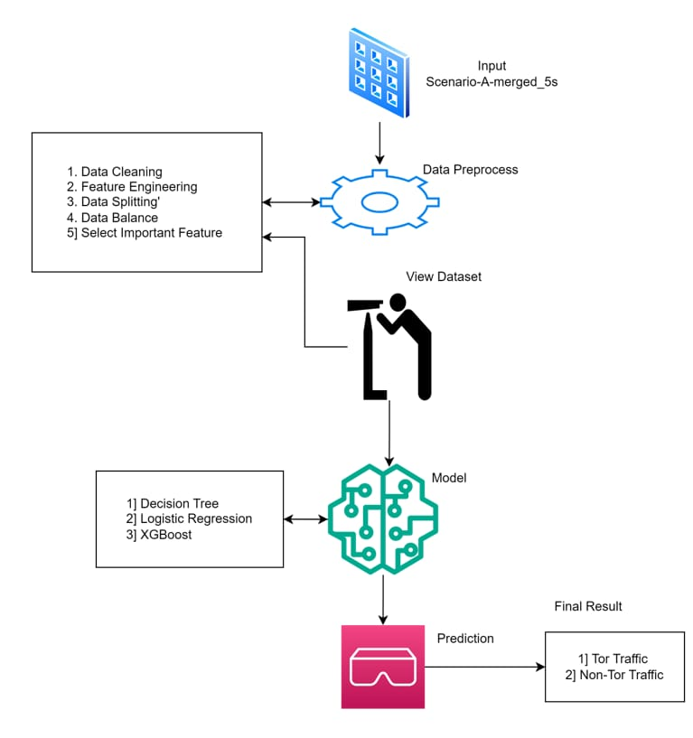
ARCHITECTURE OF PROPOSED SYSTEM

Slide 12
The dataset likely contains information on network traffic, possibly labeled as
"Tor" or "Non-Tor" traffic. The data must be cleaned by filling missing values and removing
irrelevant or redundant features. You will also normalize the data to ensure that each feature
contributes equally to the model. Removing or handling missing values, duplicates, or errors
in the data. Creating new features or modifying existing ones to improve model performance.
Dividing the data into training and testing sets to evaluate model performance.Ensuring that the dataset has a balanced number of samples for each class (e.g., Tor vs. Non-Tor) to prevent bias in the model.
Choosing the most relevant features for model training, which can enhance model accuracy and reduce computational load. You select a few machine learning algorithms that could potentially classify Tor traffic: a decision tree for simplicity, logistic regression for linear classification, and XGBoost for powerful gradient boosting.Eachmodel is trained using the preprocessed dataset. The models learn patterns and relationships in the data that allow them to predict the class of new, unseen traffic. The models are tested on aseparate test set to evaluate their performance. Metrics like accuracy, precision, recall, and F1-score are calculated, and a model comparison is made to choose the best-performing model.

Slide 13
MODULES
SYSTEM
The first module is Data Collection, where the system collects and imports the dataset consisting of various network traffic features such as Source Port, Destination Port, Protocol Type, Flow Duration, and Inter-Arrival Times. This dataset serves as the foundation for training and testing the machine learning models.
Once the data is collected, the next critical module is Data Preprocessing and Cleaning. In this phase, the system performs several operations to prepare the data for effective model training. It handles missing or null values by filling them appropriately or removing them to maintain data consistency.
The third module is Model Training and Evaluation, where the preprocessed dataset is divided into training and testing subsets. The training data is used to train different machine learning models such as Decision Tree, Logistic Regression, and XGBoost. These models learn patterns, relationships, and behavior from the input data.
The final module is Prediction and Result Generation. In this phase, the system allows users to provide new, unseen input data related to network traffic. The trained machine learning model analyzes this input and predicts whether the given traffic is benign or malicious, based on the patterns and knowledge gained during the training phase.

Slide 14
USER
The first module is View Data, where users are provided with an option to view the cleaned and preprocessed dataset. The data is displayed in a structured tabular format consisting of columns and corresponding values, allowing users to understand the nature of the features involved in the classification process.
The second module is Model Selection, which enables users to select from multiple machine learning models, including Decision Tree, Logistic Regression, and XGBoost. Upon selection, the system displays the accuracy of the chosen model, allowing users to compare the performance of different algorithms and choose the most suitable model based on their requirements.
In the third module, Give Inputs, users are required to enter specific input values for the selected features such as Source Port, Destination Port, Flow Duration, and other relevant attributes. These user-provided inputs act as new data for which the system will predict the traffic classification.
Finally, the fourth module is View Result, where the system displays the output prediction based on the trained model. The result clearly indicates whether the given network traffic is identified as Tor Traffic or Non-Tor Traffic.

Slide 15
UML DIAGRAMS
UML stands for Unified Modelling Language. UML is a standardized general purpose modelling language in the field of object oriented software engineering. The standard is managed, and was created by, the Object Management Group.
The goal is for UML to become a common language for creating models of object-oriented computer software. In its current form UML is comprised of two major components: a Metamodel and a notation. In the future, some form of method or process may also be added to; or associated with, UML.
The Unified Modelling Language is a standard language for specifying, Visualization, Constructing and documenting the artefacts of software system, as well as for business modelling and other non-software systems.
The UML represents a collection of best engineering practices that have proven successful in the modelling of large and complex systems.

Slide 16
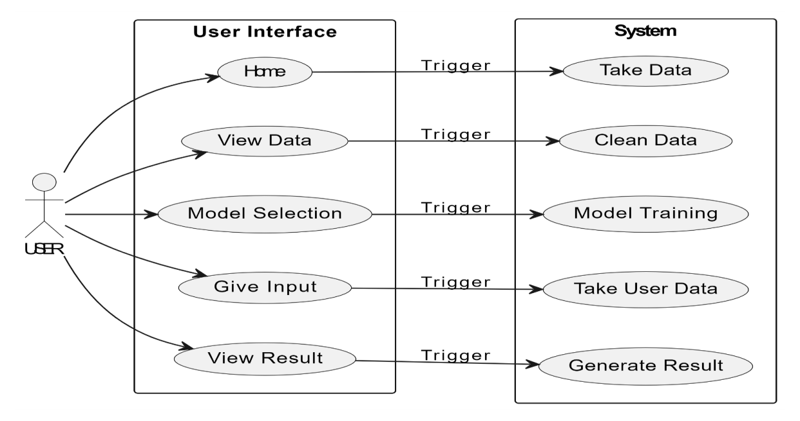
USE CASE DIAGRAM
A use case diagram in the Unified Modeling Language (UML) is a type of behavioral diagram defined by and created from a Usecase analysis.
Its purpose is to present a graphical overview of the functionality provided by a system in terms of actors, their goals (represented as use cases), and any dependencies between those use cases.
The main purpose of a use case diagram is to show what system functions are performed for which actor. Roles of the actors in the system can be depicted.

Slide 17
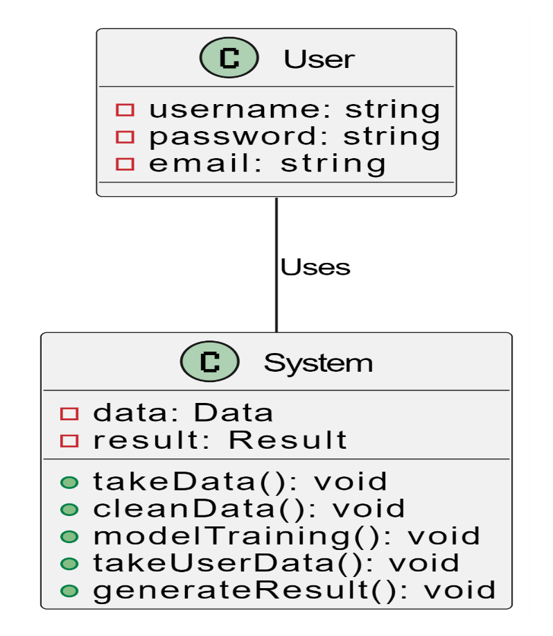
CLASS DIAGRAM
In software engineering, a class diagram in the Unified Modeling Language (UML) is a type of static structure diagram that describes the structure of a system by showing the system's classes, their attributes, operations (or methods), and the relationships among the classes. It explains which class contains information.

Slide 18
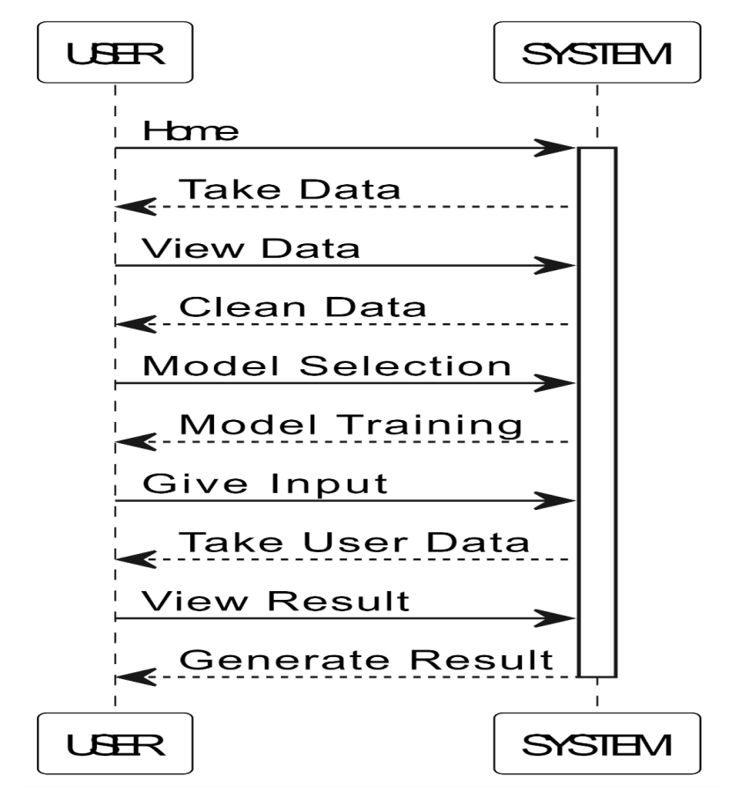
SEQUENCE DIAGRAM
A sequence diagram in Unified Modeling Language (UML) is a kind of interaction diagram that shows how processes operate with one another and in what order.
It is a construct of a Message Sequence Chart. Sequence diagrams are sometimes called event diagrams, event scenarios, and timing diagrams.

Slide 19
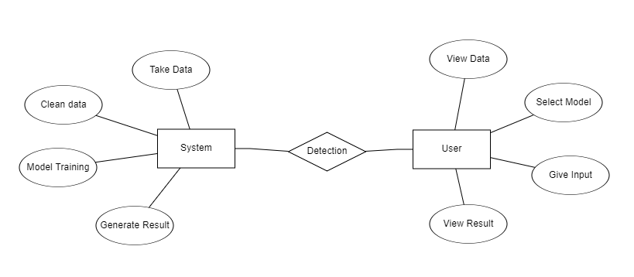
ER DIAGRAM
An Entity–relationship model (ER model) describes the structure of a database with the help of a diagram, which is known as Entity Relationship Diagram (ER Diagram). An ER model is a design or blueprint of a database that can later be implemented as a database. The main components of ER model are: entity set and relationship set.

Slide 20
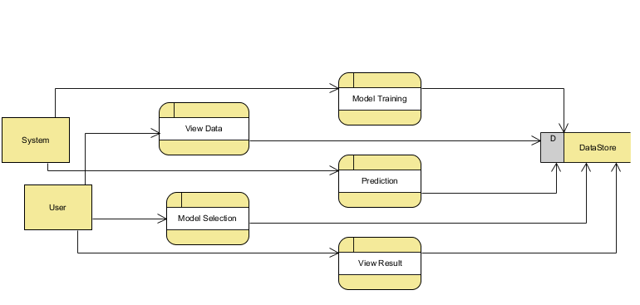
DFD DIAGRAM
A Data Flow Diagram (DFD) is a traditional way to visualize the information flows within a system. A neat and clear DFD can depict a good amount of the system requirements graphically. It can be manual, automated, or a combination of both. It shows how information enters and leaves the system, what changes the information and where information is stored. The purpose of a DFD is to show the scope and boundaries of a system as a whole. It may be used as a communications tool between a systems analyst and any person who plays a part in the system that acts as the starting point for redesigning a system.
Level 1 :

Slide 21
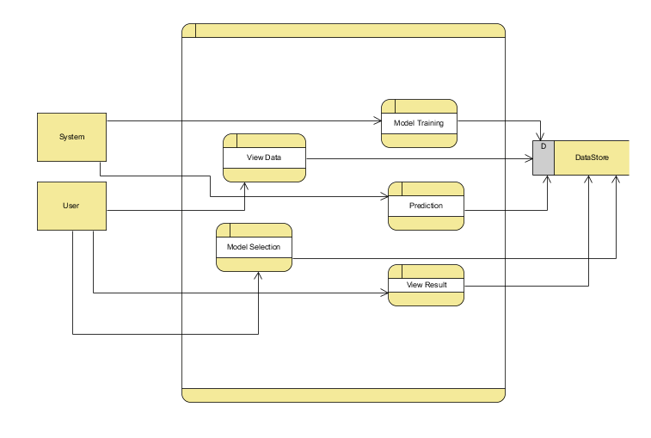
Level 2:

Slide 22
IMPLEMENTATION
SYSTEM DESIGN
Input Design:
In an information system, input is the raw data that is processed to produce output. During the input design, the developers must consider the input devices such as PC, MICR, OMR, etc.
Therefore, the quality of system input determines the quality of system output. Well-designed input forms and screens have following properties −
It should serve specific purpose effectively such as storing, recording, and retrieving the information.
It ensures proper completion with accuracy.
Objectives for Input Design:
The objectives of input design are −
To design data entry and input procedures
To reduce input volume
To design source documents for data capture or devise other data capture methods
To design input data records, data entry screens, user interface screens, etc.
To use validation checks and develop effective input controls.

Slide 23
Output Design:
The design of output is the most important task of any system. During output design, developers identify the type of outputs needed, and consider the necessary output controls and prototype report layouts.
Objectives of Output Design:
The objectives of input design are:
To develop output design that serves the intended purpose and eliminates the production of unwanted output.
To develop the output design that meets the end user’s requirements.
To deliver the appropriate quantity of output.
To form the output in appropriate format and direct it to the right person.
To make the output available on time for making good decisions.

Slide 24
CONNECTIONS
The process begins with Feature Extraction and Selection, where raw network traffic data is collected and important features such as Source Port, Destination Port, Flow Duration, Protocol Type, and Inter-Arrival Times are extracted. To enhance the performance of the machine learning models and reduce data complexity, Recursive Feature Elimination (RFE) is applied to select only the most relevant and significant features from the dataset. After selecting the essential features, the system focuses on Data Encryption, where these selected features are encrypted using the Advanced Encryption Standard (AES) algorithm. This step ensures that the sensitive data remains secure and private throughout the entire process.Once the models are trained, the next step involves Model Evaluation and Selection, where each model's performance is evaluated using metrics such as Accuracy, Precision, Recall, and F1-Score. The model that demonstrates the best performance is selected for deployment. This final trained model is then used for real-time traffic classification, allowing the system to accurately predict whether new incoming network traffic is associated with Tor or Non-Tor activity, while ensuring data security and maintaining user privacy throughout the classification process.

Slide 25

RESULT & DISCUSSION
Home: Welcome to Tor or Non-Tor Traffic Detection and Prediction
.

Slide 26
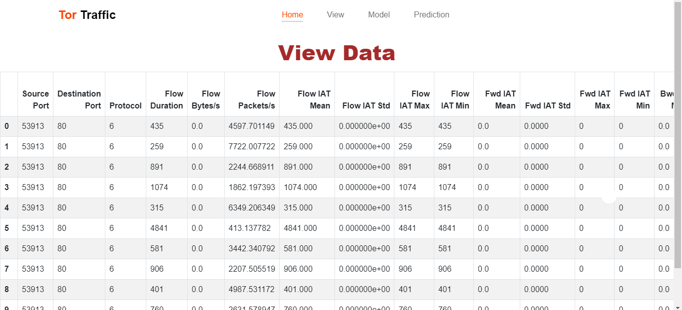
View: The view data page provides users with access to the data used for Tor or Non-Tor Traffic detection and prevention.

Slide 27
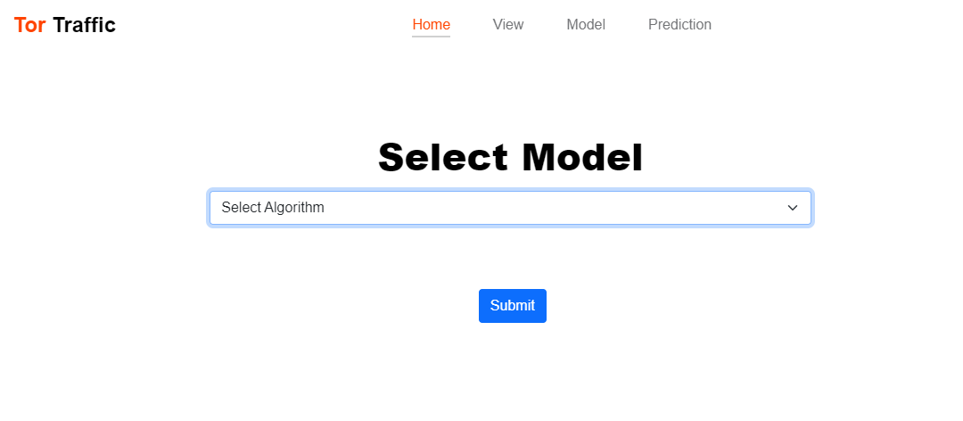
Training: We’re training the algorithm to see which one has the best accuracy.

Slide 28
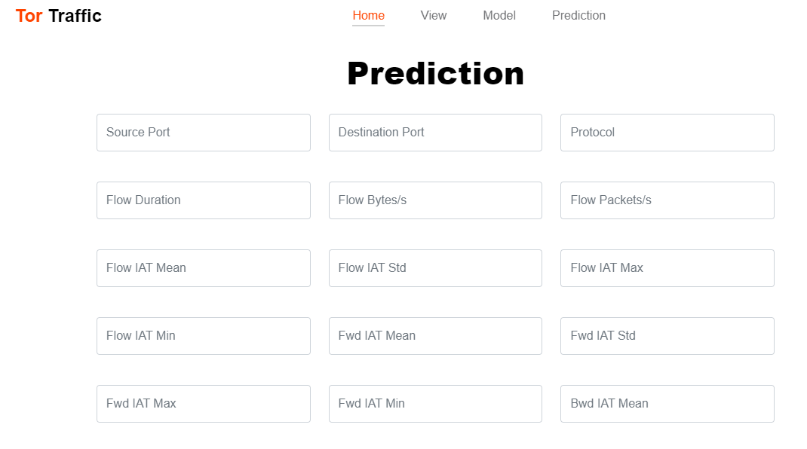
Prediction: This page show the final output of user input.

Slide 29
CONCLUSION
The classification of Tor traffic encrypted payloads using machine learning represents an important steptoward enhancing cybersecurity measures, particularly in the context of monitoring and analyzing anonymized traffic that is often used for both legitimate and malicious activities. Tor, by design, provides anonymity and privacy for its users, which has led to its adoption for both positive and negative purposes. Understanding and classifying Tor traffic is therefore crucial for developing robust cybersecurity systems capable of distinguishing between benign and malicious behaviors. This project aimed to leverage machine learning techniques to classify Tor traffic effectively, thus contributing to the broader efforts to secure network environments. The project utilized a diverse set of machine learning algorithms, including Decision Tree, Logistic Regression, and XGBoost, to classify Tor traffic. Each model brings its strengths to the task. The Decision Tree algorithm provided an easily interpretable classification model, helping us understand which features of the traffic were most relevant for distinguishing between benign and malicious activities. Logistic Regressionoffered a robust, linear approach for classification, particularly useful in binary classification tasks. Lastly, XGBoost, a gradient boosting model, outperformed the other models in terms of predictive accuracy, demonstrating its capability in handling complex, non-linear relationships in the data.

Slide 30
In conclusion, classifying Tor traffic using machine learning offers a promising approach to address the challenges of identifying and analyzing anonymous network traffic. While Tor is designed to protect user privacy and anonymity, its traffic patterns can still be categorized using sophisticated machine learning techniques. The use of machine learning in this context enables the classification of Tor traffic based on various features such as packet size, flow duration, and timing information. Deep learning models, such as convolutional neural networks (CNNs) and recurrent neural networks (RNNs), have shown great potential in accurately classifying Tor traffic by detecting subtle patterns that may not be apparent through traditional methods.
However, these models require large datasets for training and substantial computational power. On the other hand, traditional machine learning algorithms like decision trees, support vector machines (SVMs), and random forests offer faster processing times and lower resource consumption, although they may not achieve the same level of accuracy as deep learning approaches.The performance of these models also depends heavily on effective feature engineering and data preprocessing, as Tor traffic exhibits unique statistical properties. Furthermore, both approaches face challenges related to precision and recall, as well as resilience to adversarial attacks, which requires careful model tuning and regular updates to adapt to evolving Tor traffic patterns.

Slide 31
FUTURE SCOPE
Future enhancements for this study could include incorporating deep learning techniques such as Convolutional Neural Networks (CNN) and Recurrent Neural Networks (RNN) to further improve the classification accuracy of Tor traffic encrypted payloads. Additionally, expanding the dataset with more diverse and recent traffic samples could enhance model robustness. Real-time implementation and optimization for low-latency environments would be crucial for practical deployment. Moreover, integrating these models with existing cybersecurity frameworks could provide comprehensive, automated threat detection systems. Finally, exploring unsupervised learning methods might offer insights into novel traffic patterns and potential zero-day threats.Additionally, research can be extended towards privacy-preserving machine learning approaches such as Federated Learning, which enables model training across multiple decentralized devices without compromising sensitive data. This would be especially useful for organizations that need to maintain user privacy while monitoring encrypted traffic.

Slide 32
REFERENCES
[1] C. Johnson, B. Khadka, E. Ruiz, J. Halladay, T. Doleck, and R. B. Basnet, ‘‘Application of deep learning on the characterization of tor traffic using time based features,’’ J. Internet Serv. Inf. Secur., vol. 11, no. 1, pp. 44–63, 2021.
[2] O. Salman, I. H. Elhajj, A. Kayssi, and A. Chehab, ‘‘A review on machine learning-based approaches for Internet traffic classification,’’ Ann. Telecommun., vol. 75, nos. 11–12, pp. 673 710, Dec. 2020.
[3] J. Barker, P. Hannay, and P. Szewczyk, ‘‘Using traffic analysis to identify the second generation onion router,’’ in Proc. IFIP 9th Int. Conf. Embedded Ubiquitous Comput., Melbourne, VIC, Australia, Oct. 2011, pp. 72–78.
[4] S. Rezaei and X. Liu, ‘‘Deep learning for encrypted traffic classification: An overview,’’ IEEE Commun. Mag., vol. 57, no. 5, pp. 76–81, May 2019.
[5] J. Katz and Y. Lindell, Introduction to Modern Cryptography, 2nd ed. New York, NY, USA: CRC Press, 2020.

Slide 33
[6] P. Choorod and G. Weir, ‘‘Tor traffic classification based on encrypted payload characteristics,’’ in Proc. Nat. Comput. Colleges Conf. (NCCC), Mar. 2021, pp. 1–6.
[7] A. H. Lashkari, G. D. Gil, M. S. I. Mamun, and A. A. Ghorbani, ‘‘Characterization of Tor traffic using time-based features,’’ in Proc. 3rd Int. Conf. Inf. Syst. Secur. Privacy (ICISSP), Porto, Portugal, Feb. 2017, pp. 253–262.
[8] A. Cuzzocrea, F. Martinelli, F. Mercaldo, and G. Vercelli, ‘‘Tor traffic analysis and detection via machine learning techniques,’’ in Proc. IEEE Int. Conf. Big Data (Big Data), Boston, MA, USA, Dec. 2017, pp. 4474–4480.
[9] D. Sarkar, P. Vinod, and S. Y. Yerima, ‘‘Detection of tor traffic using deep learning,’’ in Proc. IEEE/ACS 17th Int. Conf. Comput. Syst. Appl. (AICCSA), Nov. 2020, pp. 1–8.
[10] N. Rust-Nguyen, S. Sharma, and M. Stamp, ‘‘Darknet traffic classification and adversarial attacks using machine learning,’’ Comput. Secur., vol. 127, Apr. 2023, Art. no. 103098.

